Slide 1


Little Stars on the Horizon:
Guiding Healthy Growth and
Watching for Delays
Presented by Heidi Kranz MS, IMH-E®
CEO, Parenting Solutions Inc.
Notes:
1:00 1 min

Slide 2

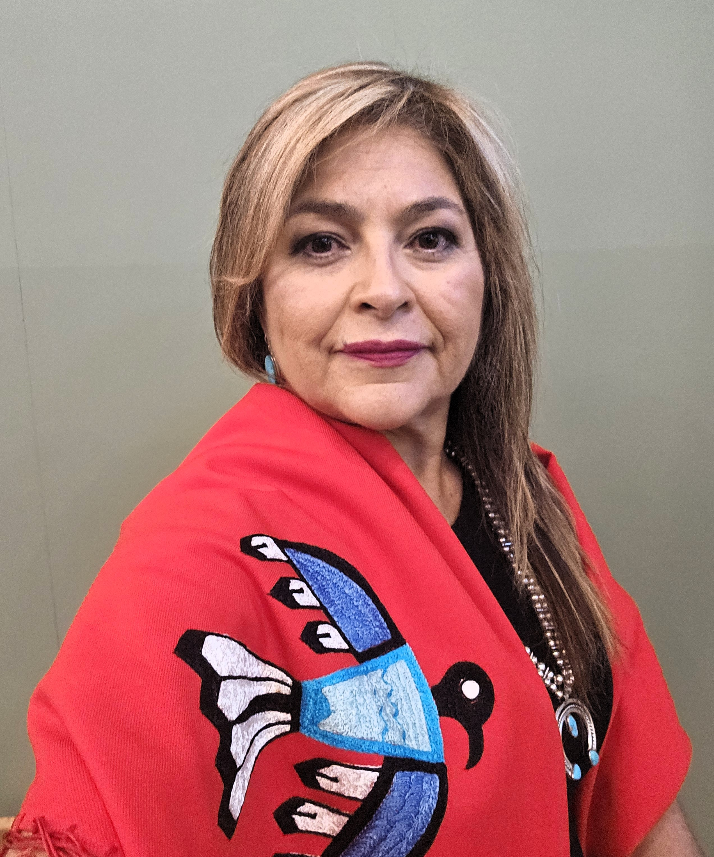


Heidi Kranz, CEO/Founder
MS, IMH-ERS®
https://www.parentingsolutions.love/
Notes:
1:01 1 min Gu waa tzi hobaa guy da wah.

Slide 3

Learning
Objectives
Describe typical developmental milestones for children from birth to age 5
Identify warning signs of developmental delays and challenges
Create a plan for engaging in conversation with families about referrals when delays are suspected.
Notes:
1:02 1 min

Slide 4

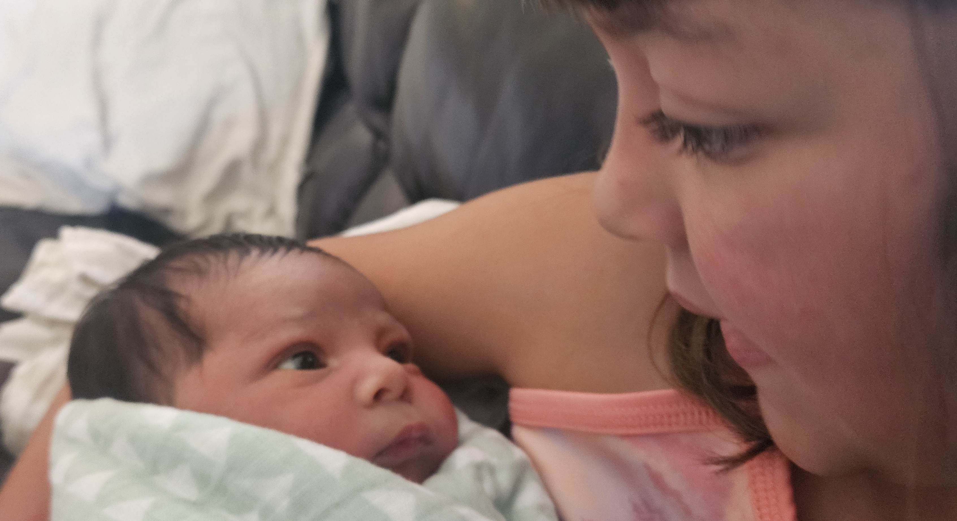
Share an observation of a child
Notes:
1:03- 1:05 (2 min)
Think of a child you know. Share a time when you observed this child do something. First words, first steps…

Slide 5

All of early development – cognitive, motor, language, and communication, growth – occurs within social and emotional development and within the system of caregiving relationships.
National Scientific Council on the Developing Child Working Paper # 1, 2004 (www.developingchild.net)
The Neurobehavioral and Social-Emotional Development of Infants and Young Children, Dr. E. Tronick, 2007
Coping in Young Children: Early Intervention Practices to Enhance Adaptive Behavior and Resilience, Drs. S. Zeitlin and G. Williamson, 1994
Notes:
1:06 1 min
Emphasize that domains interconnect and that home visitors play a key role in observing these during visits. Note that children develop at individual paces, but consistent monitoring is essential.

Slide 6

Development Domains
Domain | Description
Social/Emotional | Involves forming relationships, managing emotions, and responding to others.
Language/ Communication | Includes understanding and using words, gestures, and expressions.
Cognitive | Focuses on learning, problem-solving, and exploration.
Movement/Physical | Movement, gross motor (e.g., walking) and fine motor (e.g., grasping) skills.
Notes:
1:07 – 1:10 (3 min)
Connect shared observations to developmental domains. The Center on the Developing Child, at Harvard University, remind us that development is holistic, influenced by factors such as environment, health, family dynamics and family culture and, especially relationships! Each domain interconnects, and home visitors play a key role in observing these domains with parents and caregivers during visits. While all children develop at individual paces, consistent developmental monitoring is important.
Handout: CDC Dev Milestones and Milestone Moments Checklists CDC
Next, we will take a deep look at actual development and you will guess the developmental domain

Slide 7

Does your baby sometimes make throaty or gurgling sounds?
Notes:
1:11

Slide 8
Communication

Slide 9
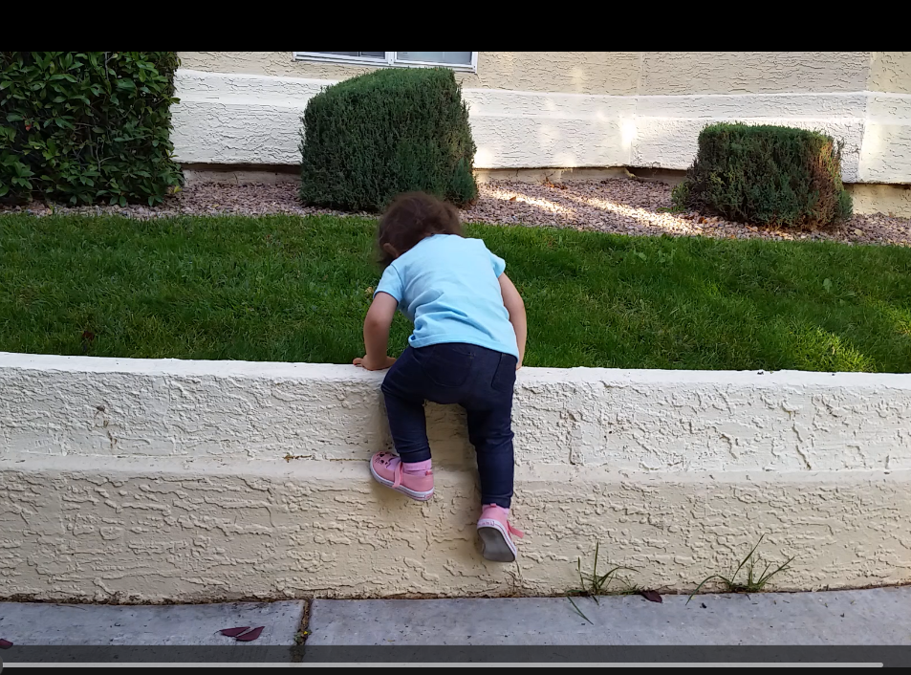
Does your baby climb onto furniture or other large objects, such as large climbing blocks?
Notes:
1:12

Slide 10
Gross Motor

Slide 11
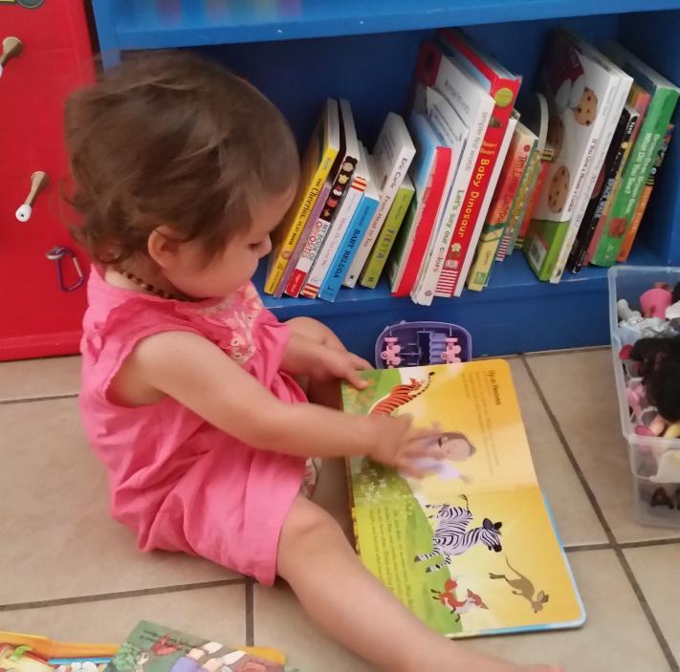
Does your child turn the pages of a book by themselves? (They may turn more than one page at a time.)
Notes:
1:13

Slide 12
Fine Motor

Slide 13
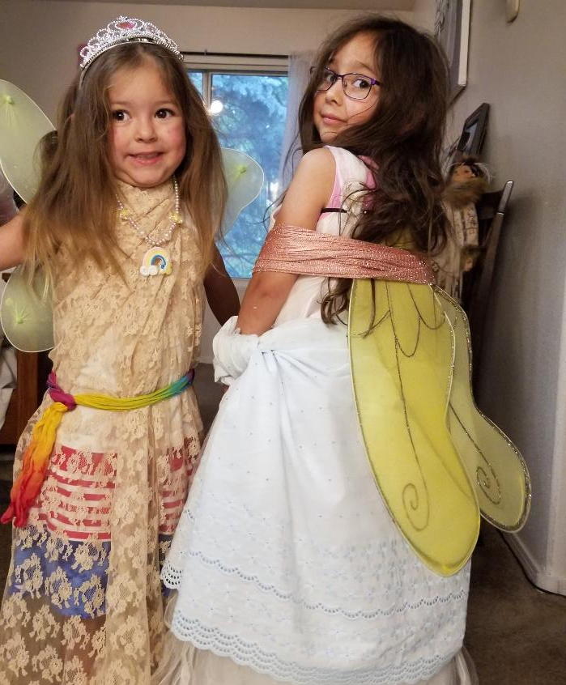
Does your child dress up and “play act,” pretending to be someone or something else?
Notes:
1:14
For example, your child may dress up in different clothes and pretend to be a mommy, daddy, superhero, an animal, or an imaginary figure.

Slide 14
Cognitive

Slide 15
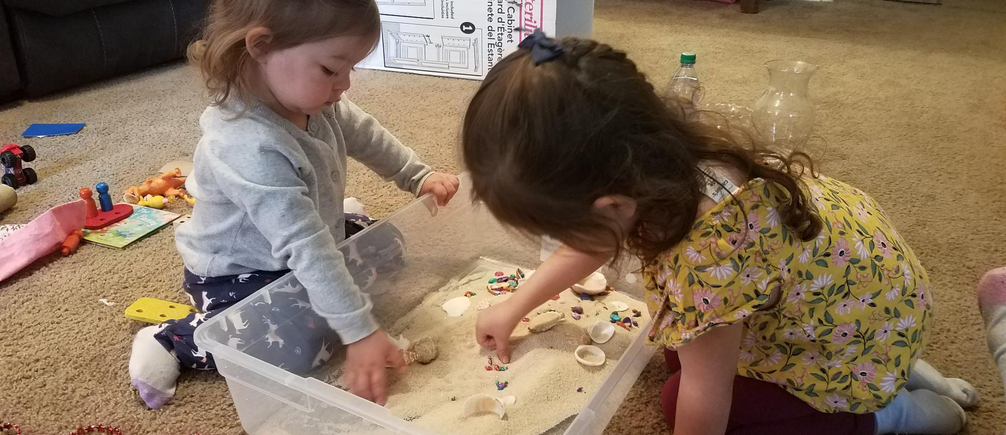
Does your child usually take turns and share with other children?
Notes:
1:15

Slide 16
Social- Emotional
Notes:
Now, let’s look a bit closer at typical developmental domains

Slide 17
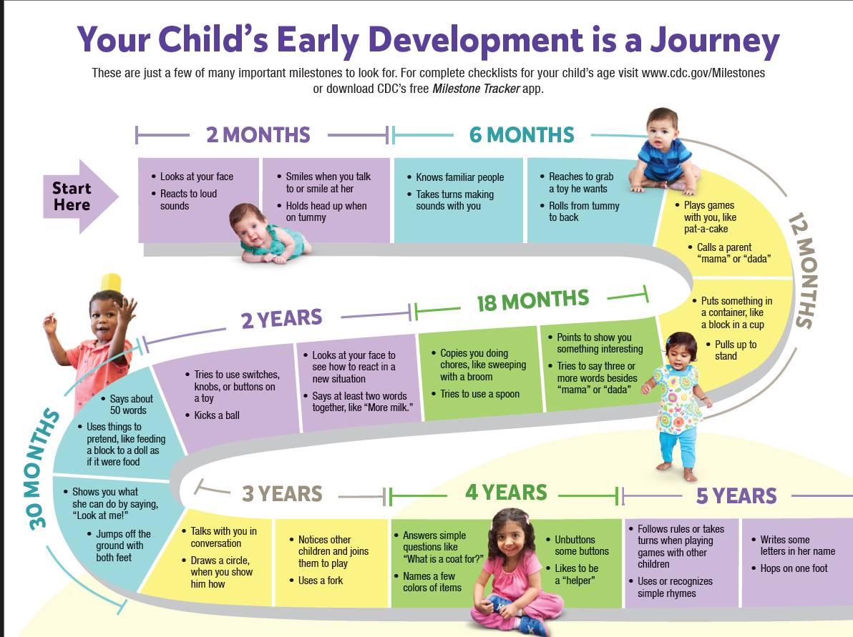
Notes:
1:16 – 1:21 5 min
Next, we’ll explore the developmental process, which is different than developmental milestones,
HANDOUT: CDC Dev Milestones and CDC Milestone Journey Brochure

Slide 18
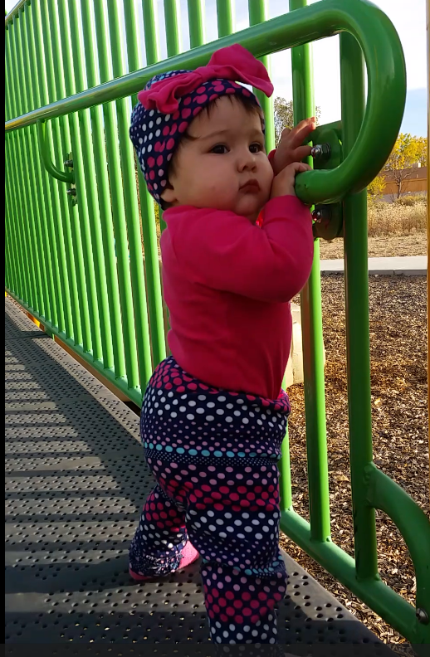
Developmental Processes:
Developmental Process
Periodic regressions
Sudden bursts of progress
Occasional periods of pauses
Notes:
1:22 2 min
Regression- when a previously acquired skill disappears temporarily. Periodic and temporary regressions are a normal part of the developmental process. These regressions are temporary and predict a big burst of progress that will come soon. Share example of a 9 month old learning how to walk and other areas of development will regress.

Slide 19


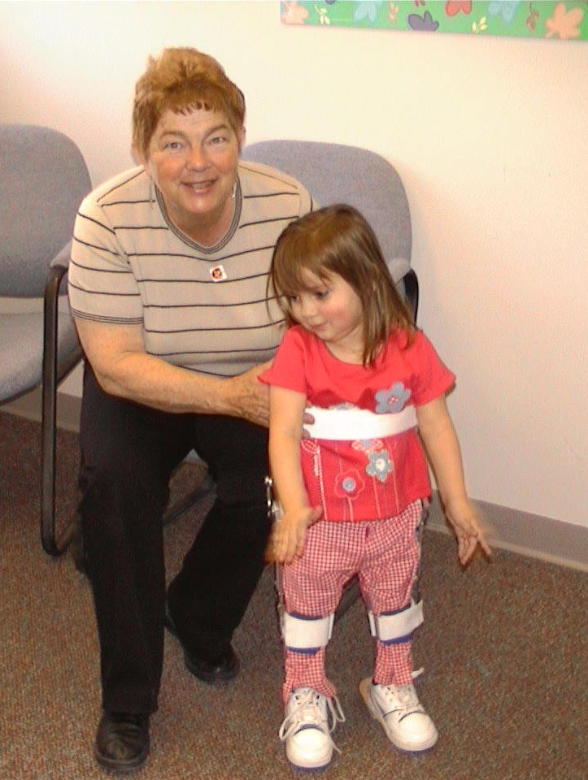
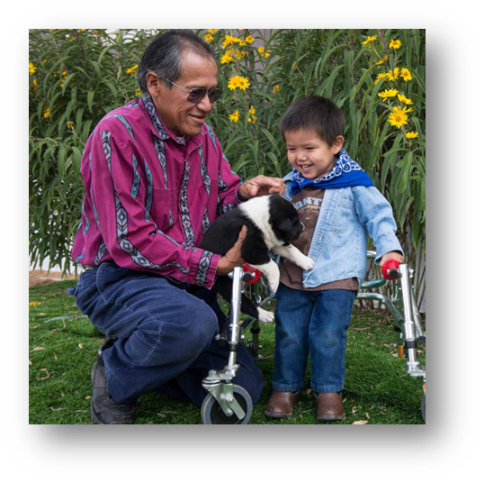
Developmental delays or challenges
If in doubt,
Check it out!
Notes:
1:25 1 min
Explain that delays occur when a child does not meet milestones within expected ranges (e.g., most children achieve by the listed ages). Red flags are often defined as failure to reach milestones or loss of skills (regression). Categorize by domain, using CDC and related sources.

Slide 20
Warning Signs
Social-Emotional:
No smiling (3 months)
Avoids eye contact or shows little interest in others (2 years)
Difficulty playing with peers (4 years)
Cognitive
Does not point to objects (18 months)
No pretend play(2 years)
Trouble with simple problem-solving (4 years)
Language-Communication
No single words (16 months)
Less than 50 words (2 years)
Cannot follow simple instructions (3 years)
Physical
Not rolling over (6 months)
Not walking (18 months)
Cannot jump (3 years)
Notes:
1:26– 1:30 4 min
Delays or challenges occur when a child does not meet milestones within expected ranges (e.g., most children achieve by the listed ages). Red flags are often defined as failure to reach milestones or loss of skills (regression). Fortunately, Home Visitors are monitoring development along with parents and have some handy tools to help screen for developmental delays and challenges such as the Ages and Stages Questionaires ASQ-3 and ASQ-SE. Home visitors are trained in how to support parents in filling out the questionnares however, sharing information and feedback when developmental delays are noticed can be challenging. The Brazelton Touchpoints Center developed a Roadmap to help…

Slide 21
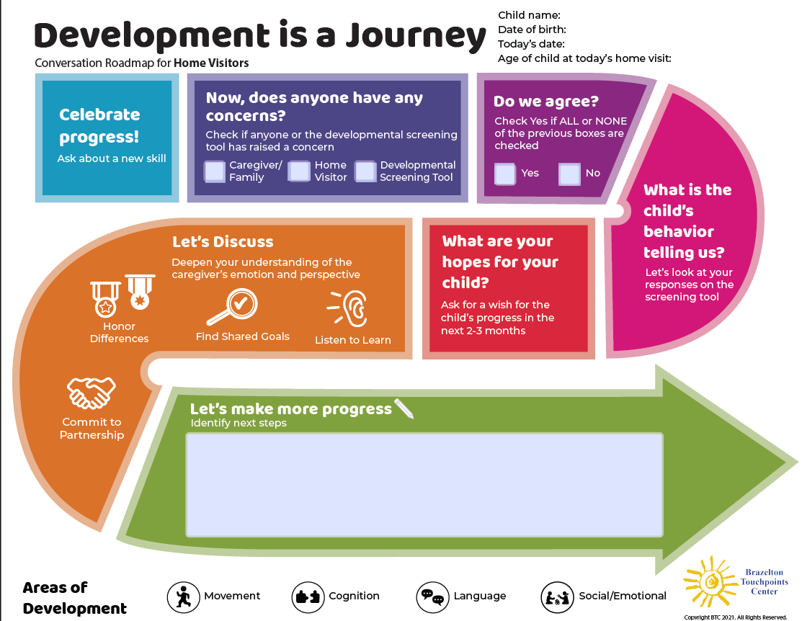
Family Conversation Roadmap for
Home Visitors
Facilitate conversations using 7 steps
Actively support parents and caregivers
Enhance the home visitor-parent partnership
Notes:
1:31 – 1:34 3 min
Conversations about developmental screening results and concerns can be time-consuming and anxiety-provoking for families and professionals. And, you are already expected to do so much with so little time during your visits. Yet the benefits are clear: when families and their provider have productive conversations about a child’s development, they are better equipped to work as a team to co-create and follow through on a collaborative plan that supports the best outcomes for the child, not just even when, but especially when parents and providers might not see things the same way. HOW we share observations and information about possible developmental delays and challenges is as important as WHAT we say. Opportunity to engage in deeper conversations. This roadmap was developed by the Brazelton Touchpoints Center and provides guidance for home visitors to share observations and concerns about development based on screening tools such as the ASQ-3. Let’s see examples of each of the 7 steps. We will then have an opportunity to practice the steps with a partner, so be sure you understand each step.
HANDOUT:

Slide 22
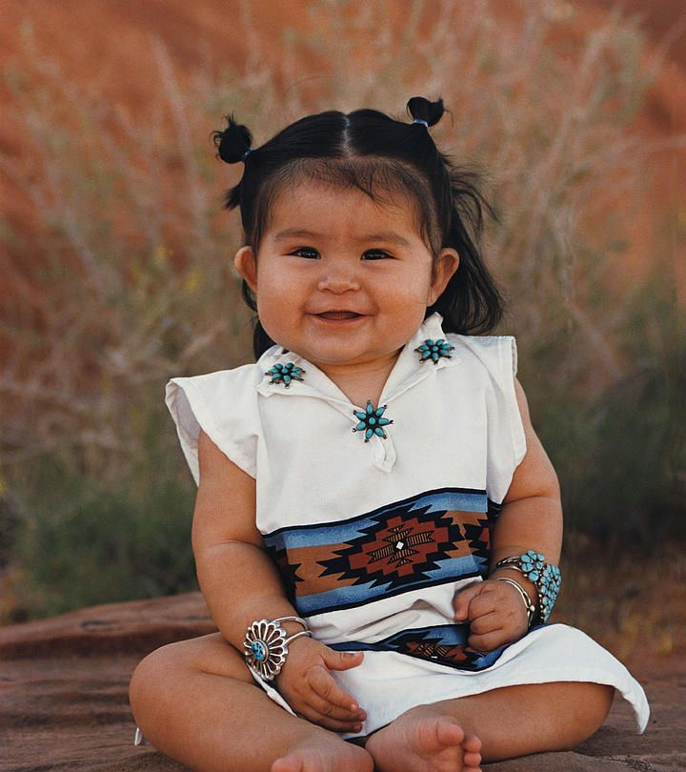
Celebrate Progress!
It's wonderful to see you and Jessie today! I noticed her reaching for you, saying "up, up," and that big smile when you picked her up—so sweet! She's clearly using words to express her needs. What other new things have you seen her learning?
Notes:
1:35 – 1:37 2 min
Thank the parent or caregiver for completing the screening tool, as it helps you understand the child better based upon their knowledge of their child.
Observe and narrate something you see the child doing in the moment, or that you’ve; seen in the course of caring for the child in your program.
Mention one activity from the screening tool that the child is now capable of doing as a way of entering into the conversation from a strengths-based stance.
Invite conversation about the child’s progress. Ask the parent about their perspective and knowledge of the child.
Narrate something you see in the parent-child interaction child that demonstrates how well they are doing together.
WHY: Conversations about developmental screening tool results provide opportunities for the provider and family to celebrate the child’s development and honor the family’s primary role in the child’s life. Finding common ground in strengths-based provider and parent observations of the child can help reduce anxiety raised by any concerns identified in the screening tool, and prepare caregivers to process potentially upsetting information.

Slide 23

Does Anyone
Have a Concern?
Thank you for completing the screening tool—it’s so helpful to understand your child’s world at home. Today, I’d love to hear more about what you shared, celebrate new milestones, and discuss any concerns you might have. Together, we can plan the next steps. How does that sound?
Notes:
1:38 – 1:40 2 min
Mark boxes accordingly to whether you as the provider, the parent, or the screening tool have any concerns about the child’s development; and what those concerns are.
WHY: This continues honoring the family perspective and role, and begins the process of inviting parents’ concerns, sharing any you may have, and screening findings. It also quickly opens up the process of discovery of differences in perspective.

Slide 24

Do We Agree?
It’s amazing to hear about Jessie’s progress, and I’ve noticed it during my visits too! Are there any concerns about her development? No? That’s great—it sounds like she’s thriving.
Looking at the screening tool, you shared fun examples of her skills across many areas. The results tell us to look closer at her language a bit more. I’ll mark “No” for now, as there’s some discrepancy, so we can keep discussing and learning more together.
Notes:
1:41 – 1:43 2 min
Mark boxes accordingly to show if there is full agreement among you, the parent, and the formal screening tool, or not.
WHY: Different perspectives are to be expected and can be quickly and safely discovered so that consensus on next steps can be reached.

Slide 25

What is the Child’s Behavior Telling Us?
I heard her chatting when I arrived—she is so excited! You mentioned she’s picking up new words…. let’s see how many words she’s using to help understand her development, as the screener flagged this area. Can you share more about what she’s saying at home? Do others understand her? And when they don’t, how does she respond?
Notes:
1:44 – 1:46 2 min
Explore specifics from the screening tool and whether there is anything about the child's behavior that may be saying the child is feeling the effects of a developmental delay; for example, a child with a language delay might exhibit frustration. This step helps parents experience your concern for the child. Make a note of the parent’s observations in the margin of the paper roadmap. For more information, contact touchpoints@childrens.harvard.edu Brazelton Touchpoints Center 1295 Boylston St, Suite 320, BCH-3111 Boston, MA 02215
Brazelton Touchpoints Center
WHY: We as practitioners can inquire about or describe children’s behavior without interpreting, inviting the parent to offer what they feel the child’s behavior means.

Slide 26
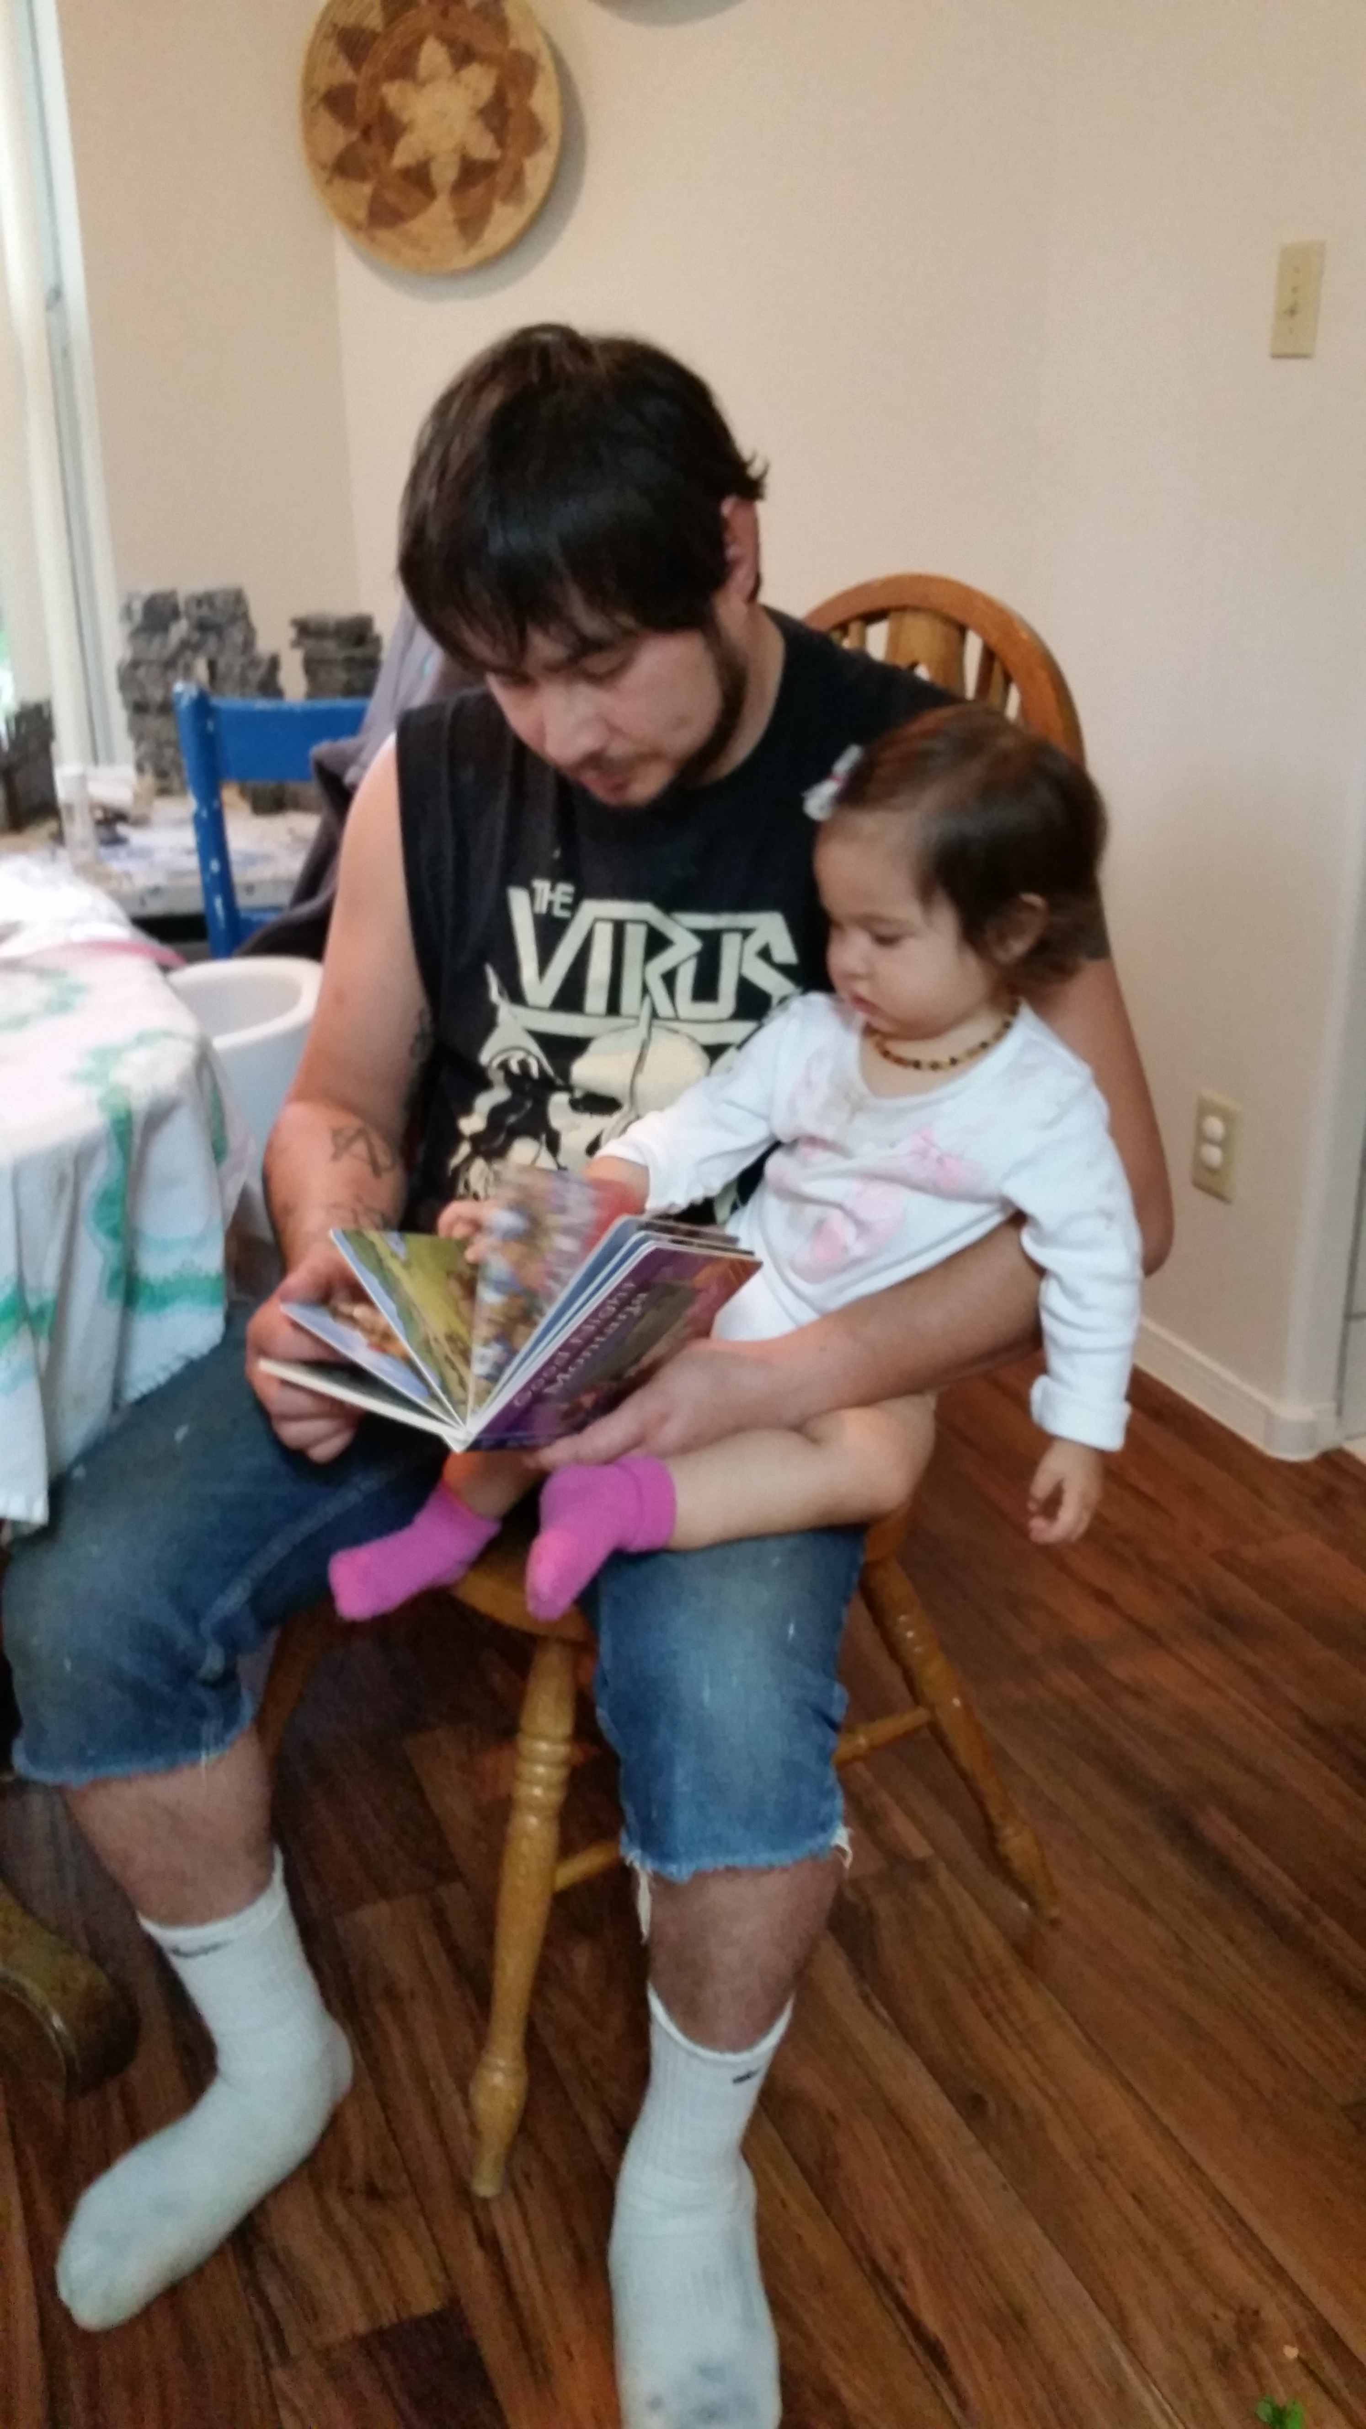
What Are Your Hopes for Your Child?
I’m thrilled to see your child’s progress! To make sure we are on the same page, I’d love to hear what you hope to see in her development over the next few months, especially in areas where we have some questions.
Notes:
1:47 – 1:49 2 min
To set the tone for the discussion that follows, ask the parent caregiver about their hopes and goals for their child’s development over the next few months. This provides an opportunity to join the parent even — perhaps especially — if there was not earlier agreement on a concern. All parents want their child to make progress and you can join them in their hopes and goals.
WHY: Asking caregivers about their hopes for their child is a powerful way for you to communicate your concern — and intention to support the parents’ priorities. It signals to parents that you care about the whole child and paves the way for engaging parents in next steps and referrals in service of their hopes and goals, even if they don’t agree with you or the screening tool about a potential delay.

Slide 27


Let’s Discuss
“It looks like we see some things differently. I want to be sure I understand what you see so that we can work together to help your child make the progress you want.
How can we best do that?”
Notes:
1:50 – 1:52 2 min
Ask for the parent’s observations, for more details about areas of agreement and differences in perspective, digging into the developmental domains depicted at the bottom of the Roadmap. Test out and then affirm your understanding of areas of agreement with the parent first. If necessary, agree to disagree. Commit to partnering together on next steps, which may include a plan to learn together and revisit areas of disagreement as the child continues to develop, and, if relevant, to be open to what subsequent screening or evaluation might reveal.
Why: It is essential to your alliance to ask for details that honor parents’ perspectives. When you show interest in these details, parents are more likely to open up and engage, even if they disagree with you. If you show willingness to not have this become a conflict of opinion but rather a plan for progress, parents will more likely warm to your concern for their child.

Slide 28
Let’s Make More Progress – Next Steps
“Let’s explore what comes next. These steps feel important to both of us, and I’d love to add a few more suggestions- what would you like to see next?”
  Re-screen in two months and review progress
  Share the screening results and concerns with your health care provider
  Connect with the FIT early intervention program
“What questions do you have about this journey?”
Notes:
1:48 – 1:50 2 min
Find shared goals
Listen to learn
Honor differences
Commit to partnership
Assess what the caregiver is ready for. Present follow-up steps to consider together, including those indicated in the Roadmap’s “Next Steps”. Check in with the parent to determine their level of understanding of and support for these steps. Inquire about any concerns or hesitations. Discuss possible timelines for these steps. Write out next steps with the caregiver.
WHY: Documenting next steps gives caregivers a reminder of this important conversation which they can keep and save, and share with other providers involved in the life of their child. Seeing the variety of possible steps gives them an understanding of their options and potential resources. When parents know that there are options for them to choose from, they may feel more in control and better able to cope.

Slide 29
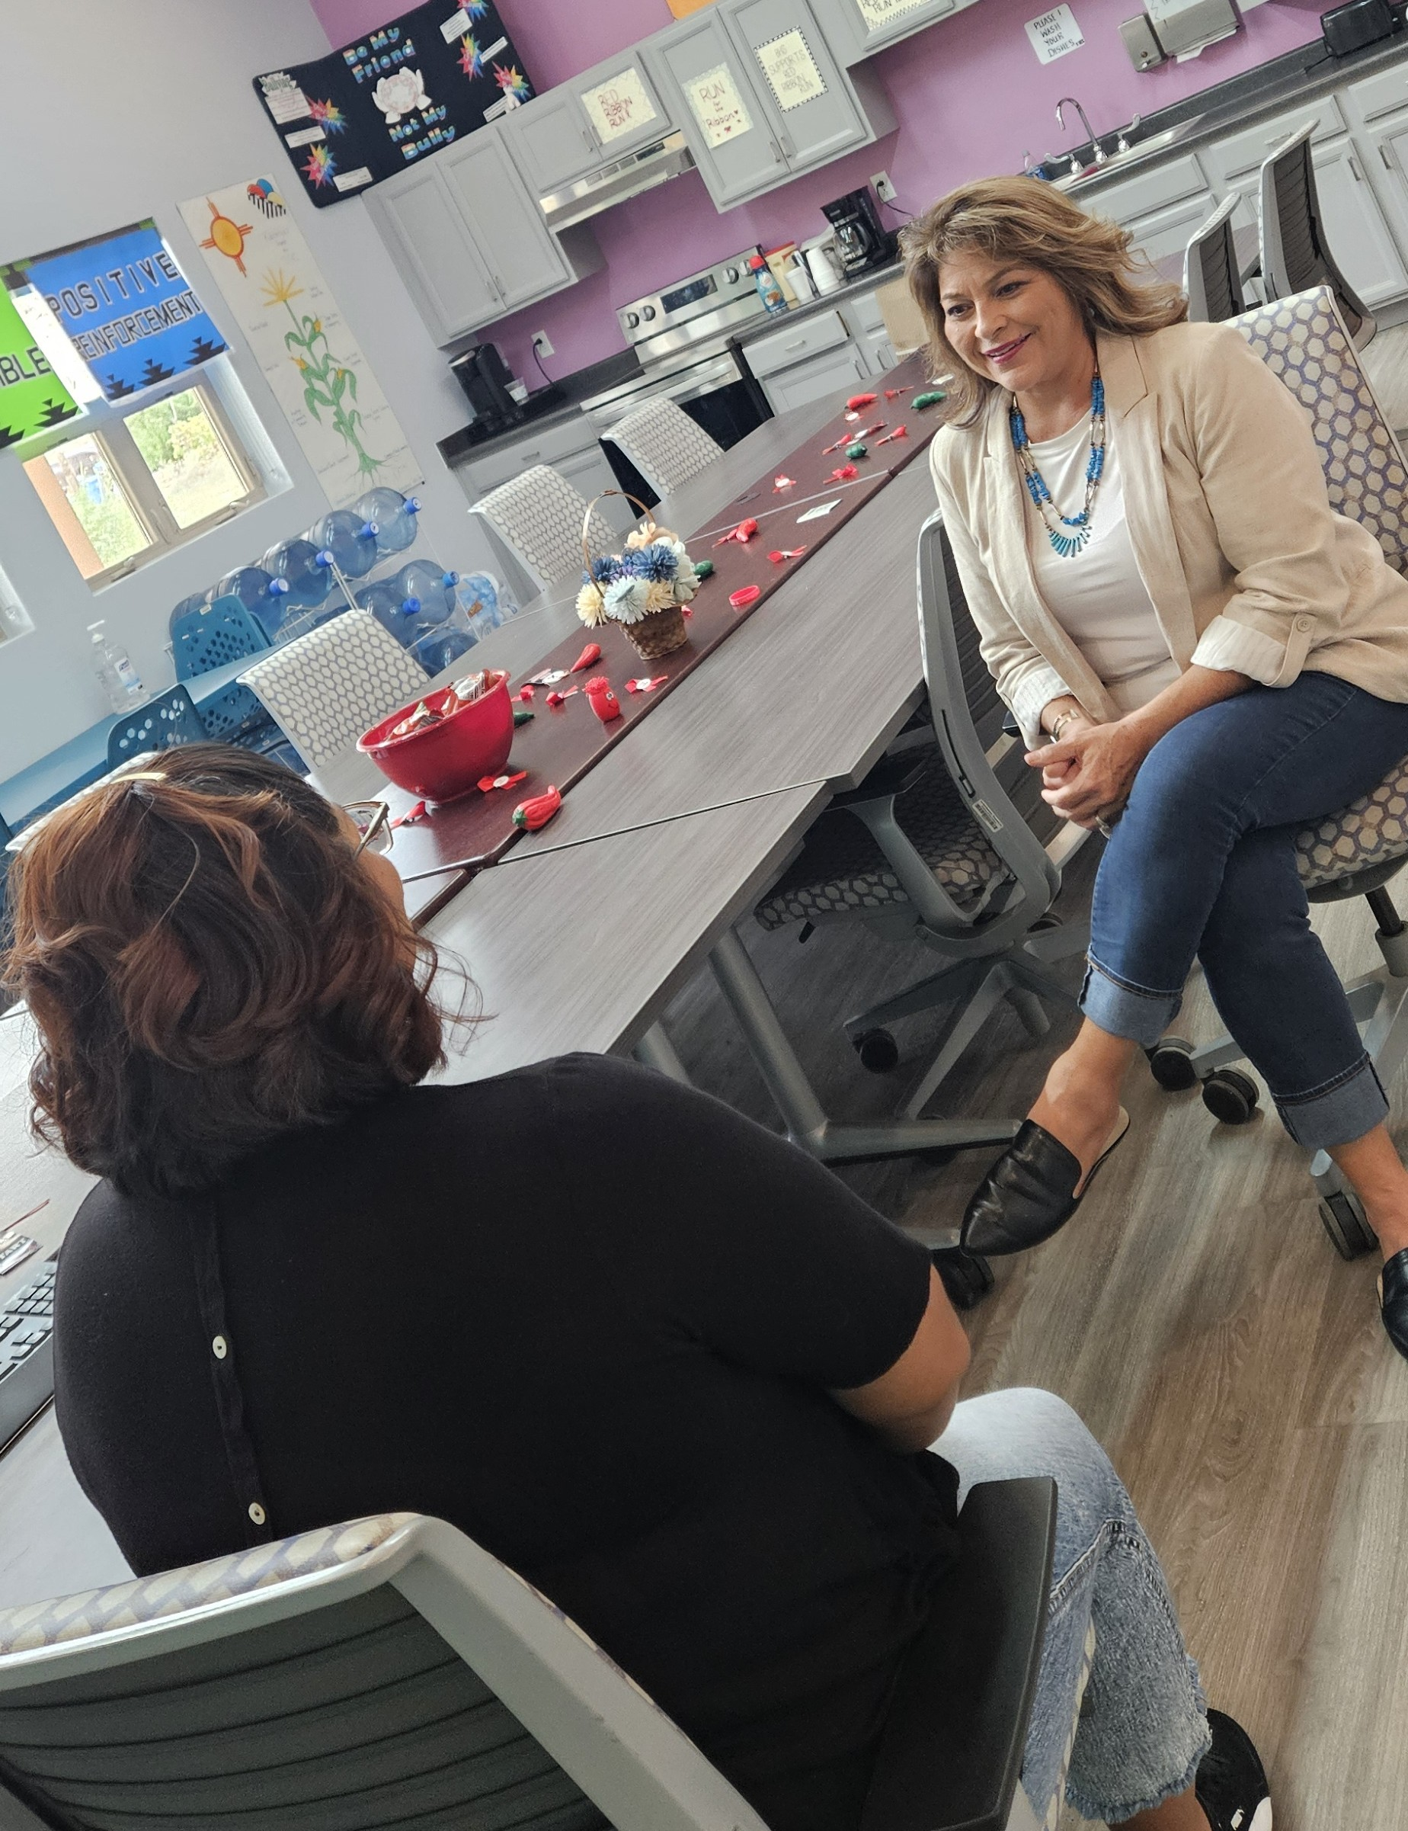
Pair and Share
Find a partner
Choose who will be the parent and who will be the Home Visitor
Practice sharing next steps using script on next slide
Switch roles after 3 minutes
Notes:
1:50 – 2:00
6 min practice 3 minutes, then switch
4 minute debrief

Slide 30
Practice Script:
“Let’s explore what comes next. These steps feel important to both of us, and I’d love to add a few more suggestions—what would you like to see next?”
  Re-screen in two months and review progress
  Share the screening results and concerns with your health care provider
  Connect with the FIT early intervention program
“What questions do you have about this journey?”
Notes:
1:50 – 2:05 15 min
6 min practice
4 minute debrief

Slide 31

Support for Families:
Family Infant Toddler Program (FIT)
FIT provides FREE early intervention services to over 14,000 children from birth to age three.
Every County in New Mexico has a FIT agency
Must make three attempts to contact you within ten days of the initial referral
Providers list:
https://www.nmececd.org/early-childhood-professionals/fit-program/
Notes:
2:06 1 min
Copy of FIT Providers by county. These agencies are funded through a combination of state and federal funds, including Medicaid, IDEA Part C, and private health insurance. You do not need private health insurance to quality for FIT. If your child is eligible for FIT services, you

Slide 32
Eligibility for the
Family Infant Toddler (FIT) Program
Developmental Delay: Delays in development of 25% or more
Established Condition: A diagnosed medical condition such as Down Syndrome or Autism Spectrum Disorder
Biological/Medical Risk: Prematurity, low birth weight, tongue-tie
Environmental Risk: Environments that post substantial threats to development including substance use, risk of child maltreatment, or developmental or psychiatric disability in a primary caregiver.
Notes:
2:07 2 min
Anyone who has a concern about a child’s development may make a referral. This includes parents, guardians, foster parents and family members; professionals such as pediatricians, other physicians, social workers, nurses or childcare providers; or others who have contact with the child.
Once a referral is made, a Family Service Coordinator will contact you and schedule an evaluation. The Family Service Coordinator must make at least three attempts to contact you within 10 days of receiving the referral.

Slide 33
FIT Services:
Educational interventions
Behavioral interventions such as Applied Behavior Analysis (ABA), Social Workers
Speech-Language support
Occupational and Physical Therapy
Medical Interventions/Nurse Support
Evaluations
Service Coordination/Case Management
Social Skills Development
Home-based
Center-based
Notes:
2:10 2 min
Educational Interventions: These services provide specialized instruction and strategies to help children develop academic and social skills that may be delayed. This can include tailored learning plans and classroom support.
Behavioral Interventions: These involve teaching children new skills and behaviors through positive reinforcement techniques. Programs like Applied Behavior Analysis (ABA) are commonly used to encourage positive behaviors and reduce negative ones.
SpeechLanguage Interventions: These services focus on improving communication skills, including both verbal and non-verbal communication. Speech therapy and Picture Exchange Communication Systems (PECS) are examples of methods used to enhance language development.
Occupational and Physical Therapy: These therapies help children develop fine motor skills, coordination, and physical abilities. Occupational therapy focuses on daily living skills, while physical therapy addresses gross motor skills and movement.
Medical Interventions: These services may include health assessments, medication management, and coordination with healthcare providers to address specific health conditions that could impact development.
Evaluations: Early intervention services typically begin with a professional evaluation to assess a child's specific needs and create an Individualized Family Service Plan (IFSP).
Service Coordination/Case Management: A service coordinator helps families navigate the early intervention system, ensuring access to necessary services and support.
Social Skills Development Programs: These programs focus on enhancing a child's ability to interact with peers and understand social cues, often through group sessions or one-on-one interactions.
HomeBased Programs: These services are delivered in the child's home, providing a flexible option for families to receive support tailored to their environment.
CenterBased Programs: These involve specialized facilities where children receive various therapies in a structured setting, allowing for focused intervention.

Slide 34
FIT Referral Steps
Referral
Intake
Evaluation
Service Plan
Call
1-877-696-1472
Fax
1-866-829-8838
https://www.nmececd.org/family-infant-toddler-fit-program/
Notes:
2:12 1 min
Anyone who has a concern about a child’s development can make a referral. This includes parents, guardians, foster parents and family members, professionals such as pediatricians, other physicians, social workers, nurses, home visitors, childcare providers, or others who have contact with the child.
It is not necessary to determine a diagnosis or a delay prior to making a referral. Simply the fact that you are concerned about the child’s development is enough to generate a referral
Information Required: When making a referral, you will need to provide basic information about the child, including the date of
birth family information, and the reason for the referral.

Slide 35


Share something new you learned about supporting families and young children’s development that you want to practice next week with families.
Notes:
2:13 2 min

Slide 36

Dah wa eh!
Thank you!
https://www.parentingsolutions.love/
Notes:
2:15 1 min Gu waa tzi hobaa guy da wah.

